Slide 1

Map Pattern
Parallel Computing
CIS 410/510
Department of Computer and Information Science

Slide 2
Table of Contents
Map
Optimizations
Sequences of Maps
Code Fusion
Cache Fusion
Related Patterns
Example Implementation: Scaled Vector Addition (SAXPY)
Problem Description
Various Implementations

Slide 3
Table of Contents
Map
Optimizations
Sequences of Maps
Code Fusion
Cache Fusion
Related Patterns
Example Implementation: Scaled Vector Addition (SAXPY)
Problem Description
Various Implementations

Slide 4
Mapping
“Do the same thing many times”
foreach i in foo:
do something
Well-known higher order function in languages like ML, Haskell, Scala
map:
applies a function each element in a list and returns a list of results

Slide 5
Example Maps
Add 1 to every item in an array
Double every item in an array
0
1
2
3
4
5
0
1
2
3
4
5
0
4
5
3
1
0
3
7
0
1
4
0
1
5
6
4
2
1
6
14
0
2
8
0
Key Point: An operation is a map if it can be applied to each element without knowledge of neighbors.

Slide 6
Key Idea
Map is a “foreach loop”

Slide 7
Key Idea
Map is a “foreach loop” where each iteration is independent

Slide 8
Key Idea
Map is a “foreach loop” where each iteration is independent
Embarrassingly Parallel
Independence is a big win. We can run map completely in parallel. Significant speedups! More precisely: is O(1) plus implementation overhead that is O(log n)…so .

Slide 9
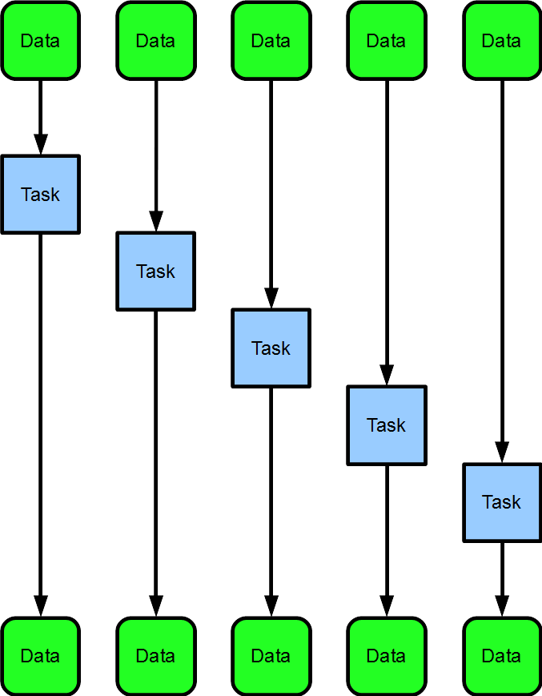
Sequential Map
for(int n=0;
n< array.length;
++n){
process(array[n]);
}
Time

Slide 10
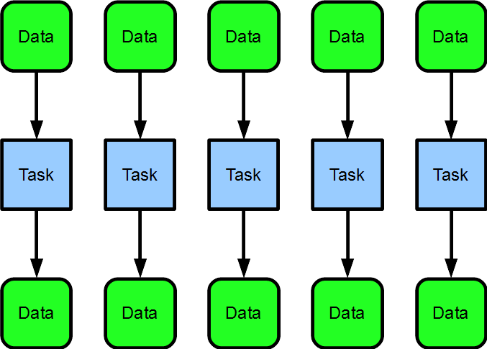
Parallel Map
parallel_for_each(
x in array){
process(x);
}
Time

Slide 11
Comparing Maps
Serial Map
Parallel Map

Slide 12
Comparing Maps
Serial Map
Parallel Map
Speedup
The space here is speedup. With the parallel map, our program finished execution early, while the serial map is still running.

Slide 13
Independence
The key to (embarrasing) parallelism is independence

Slide 14
Independence
The key to (embarrasing) parallelism is independence
Modifying shared state breaks perfect independence
Results of accidentally violating independence:
non-determinism
data-races
undefined behavior
segfaults
Warning: No shared state!
Map function should be “pure” (or “pure-ish”) and should not modify shared states

Slide 15
Implementation and API
OpenMP and CilkPlus contain a parallel for language construct
Map is a mode of use of parallel for
TBB uses higher order functions with lambda expressions/“funtors”
Some languages (CilkPlus, Matlab, Fortran) provide array notation which makes some maps more concise
Array Notation
A[:] = A[:]*5;
is CilkPlus array notation for “multiply every element in A by 5”

Slide 16
Unary Maps
Unary Maps
So far we have only dealt with mapping over a single collection…

Slide 17
Map with 1 Input, 1 Output
0
1
2
3
4
5
6
7
8
9
10
11
x
3
7
0
1
4
0
0
4
5
3
1
0
result
6
14
0
2
8
0
0
8
10
6
2
0
int oneToOne ( int x[11] ) {
return x*2;
}

Slide 18
N-ary Maps
N-ary Maps
But, sometimes it makes sense to map over multiple collections at once…

Slide 19
Map with 2 Inputs, 1 Output
0
1
2
3
4
5
6
7
8
9
10
11
x
3
7
0
1
4
0
0
4
5
3
1
0
y
2
4
2
1
8
3
9
5
5
1
2
1
result
5
11
2
2
12
3
9
9
10
4
3
1
int twoToOne ( int x[11], int y[11] ) {
return x+y;
}

Slide 20
Table of Contents
Map
Optimizations
Sequences of Maps
Code Fusion
Cache Fusion
Related Patterns
Example Implementation: Scaled Vector Addition (SAXPY)
Problem Description
Various Implementations

Slide 21
Table of Contents
Map
Optimizations
Sequences of Maps
Code Fusion
Cache Fusion
Related Patterns
Example Implementation: Scaled Vector Addition (SAXPY)
Problem Description
Various Implementations

Slide 22
Sequences of Maps
Often several map operations occur in sequence
Vector math consists of many small operations such as additions and multiplications applied as maps
A naïve implementation may write each intermediate result to memory, wasting memory BW and likely overwhelming the cache

Slide 23
Table of Contents
Map
Optimizations
Sequences of Maps
Code Fusion
Cache Fusion
Related Patterns
Example Implementation: Scaled Vector Addition (SAXPY)
Problem Description
Various Implementations

Slide 24
Code Fusion
Can sometimes “fuse” together the operations to perform them at once
Adds arithmetic intensity, reduces memory/cache usage
Ideally, operations can be performed using registers alone

Slide 25
Table of Contents
Map
Optimizations
Sequences of Maps
Code Fusion
Cache Fusion
Related Patterns
Example Implementation: Scaled Vector Addition (SAXPY)
Problem Description
Various Implementations

Slide 26
Cache Fusion
Sometimes impractical to fuse together the map operations
Can instead break the work into blocks, giving each CPU one block at a time
Hopefully, operations use cache alone

Slide 27
Table of Contents
Map
Optimizations
Sequences of Maps
Code Fusion
Cache Fusion
Related Patterns
Example Implementation: Scaled Vector Addition (SAXPY)
Problem Description
Various Implementations

Slide 28
Overview
Three patterns related to map are discussed here:
Stencil
Workpile
Divide-and-Conquer
They will be discussed more in detail in a later lecture.

Slide 29
Stencil
Each instance of the map function accesses neighbors of its input, offset from its usual input
Common in imaging and PDE solvers

Slide 30
Workpile
Work items can be added to the map while it is in progress, from inside map function instances
Work grows and is consumed by the map
Workpile pattern terminates when no more work is available

Slide 31
Divide-and-Conquer
Applies if a problem can be divided into smaller subproblems recursively until a base case is reached that can be solved serially

Slide 32
Table of Contents
Map
Optimizations
Sequences of Maps
Code Fusion
Cache Fusion
Related Patterns
Example Implementation: Scaled Vector Addition (SAXPY)
Problem Description
Various Implementations

Slide 33
Table of Contents
Map
Optimizations
Sequences of Maps
Code Fusion
Cache Fusion
Related Patterns
Example Implementation: Scaled Vector Addition (SAXPY)
Problem Description
Various Implementations

Slide 34
Problem Description
Scales vector x by a and adds it to vector y
Result is stored in input vector y
Comes from the BLAS (Basic Linear Algebra Subprograms) library
Every element in vector x and vector y are independent

Slide 35
Visual:
0
1
2
3
4
5
6
7
8
9
10
11
a
4
4
4
4
4
4
4
4
4
4
4
4
*
x
2
4
2
1
8
3
9
5
5
1
2
1
+
y
3
7
0
1
4
0
0
4
5
3
1
0
y
11
23
8
5
36
12
36
49
50
7
9
4

Slide 36
Visual:
0
1
2
3
4
5
6
7
8
9
10
11
a
4
4
4
4
4
4
4
4
4
4
4
4
*
x
2
4
2
1
8
3
9
5
5
1
2
1
+
y
3
7
0
1
4
0
0
4
5
3
1
0
y
11
23
8
5
36
12
36
49
50
7
9
4
Twelve processors used → one for each element in the vector

Slide 37
Visual:
0
1
2
3
4
5
6
7
8
9
10
11
a
4
4
4
4
4
4
4
4
4
4
4
4
*
x
2
4
2
1
8
3
9
5
5
1
2
1
+
y
3
7
0
1
4
0
0
4
5
3
1
0
y
11
23
8
5
36
12
36
49
50
7
9
4
Six processors used → one for every two elements in the vector

Slide 38
Visual:
0
1
2
3
4
5
6
7
8
9
10
11
a
4
4
4
4
4
4
4
4
4
4
4
4
*
x
2
4
2
1
8
3
9
5
5
1
2
1
+
y
3
7
0
1
4
0
0
4
5
3
1
0
y
11
23
8
5
36
12
36
49
50
7
9
4
Two processors used → one for every six elements in the vector

Slide 39
Table of Contents
Map
Optimizations
Sequences of Maps
Code Fusion
Cache Fusion
Related Patterns
Example Implementation: Scaled Vector Addition (SAXPY)
Problem Description
Various Implementations

Slide 40
Serial SAXPY Implementation

Slide 41
TBB SAXPY Implementation

Slide 42
Cilk Plus SAXPY Implementation

Slide 43
OpenMP SAXPY Implentation

